Slide 1
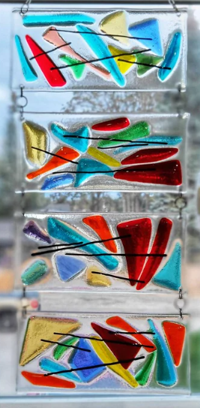
Abstract Fused Glass

Slide 2
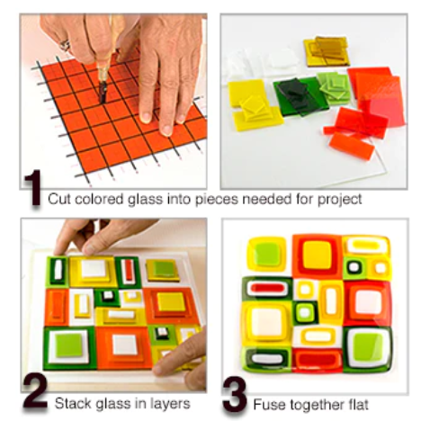
What is Glass Fusing
Glass Fusing is simply the process of stacking two or more layers of compatible glass together to make a design, then placing the stacked glass into your kiln, where it melts together.

Slide 3
Assembly
A project generally begins with a base layer (often one or two pre-cut glass Blanks) with a design layer on top, including glass accents, border details and focal elements.

Slide 4
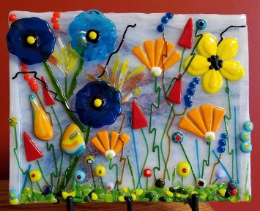
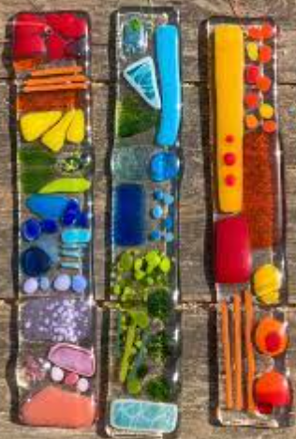
Flat Firing
After assembly, the project is placed in the kiln and slowly taken from room temperature up to 1300-1500 degrees Fahrenheit.
Different effects can be created by combining the variables of time and temperature.

Slide 5
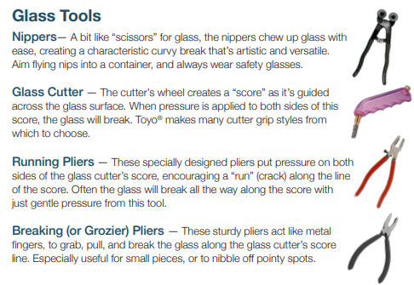
Tools Used

Slide 6
Types of Fusing
Tack Fuse
Contour Fuse
Full Fuse
Tack Fuse – Glass pieces are fused together with little deformation beyound softening or rounding of edges
Contour Fuse – Glass pieces are fused together, edges are soft and rounded, project surface retains a degree of dimension
Full Fused - Glass pieces are completely conjoined into a single uniform layer. Top surface is smooth and void of dimension or relief.

Slide 7
Types of Fusing
Tack Fuse – Glass pieces are fused together with little deformation beyond softening or rounding of edges. Preserves most amount of detail in the project.
Contour Fuse – Glass pieces are fused together, edges are soft and rounded, project surface retains a degree of dimension. Use contour when layers need to be more fully combined, but detail is desired.
Full Fused - Glass pieces are completely conjoined into a single uniform layer. Top surface is smooth and void of dimension or relief.

Slide 8
Volume and Shape
Glass will naturally seek to become a circular puddle about ¼” (6mm) thick.
If it is more than 2 layers of glass, it will spread out.
If it is thinner, it will draw in, ever seeking that ¼” thickness.

Slide 9
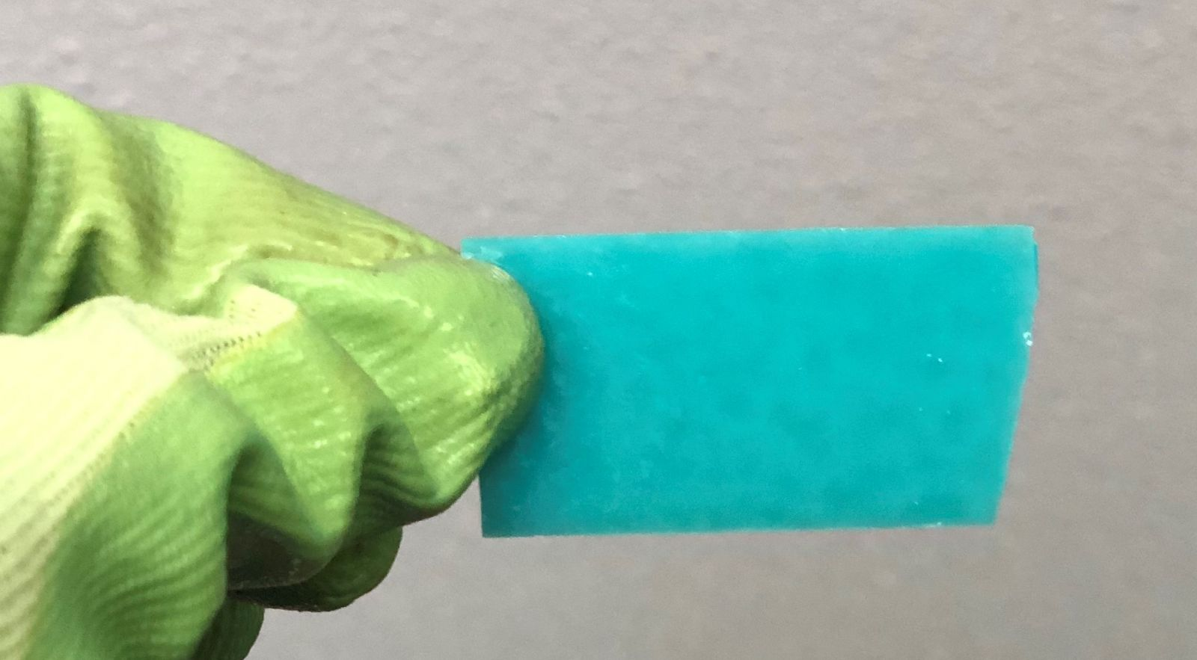
Safety
Never brush glass off your work area with your hands. Use a bench brush.
When picking out glass, use your bowl or plate to transport back to your table. Do NOT CARRY IN YOUR BARE HANDS!
Do NOT carry the base plate away from the table. An Adult will pick it up when it is completed.
Do not hold more than one piece of glass at a time.
When holding the glass, carefully hold it at the edge (to avoid fingerprints) but not by the edges (where it could cut you)

Slide 10
When finished
Any glass not used when they finish, must put back in the correct bin.
Tell an adult that you are finished and they will move your project to the cart.

Slide 11
Instructions:
Write your first name and teacher's name on the kiln paper provided. The glass base plate needs to stay on this paper in order to identify who it belongs to.
Write at the bottom of the paper.
Wait to be told when to pick out glass. Only 6 people at the glass table at one time.
Pick out your glass and carry it back to your plate at the table. Create your design.
Go back to glass table as needed to return or pick up new pieces. (Remember, only 6 people can be at the glass table at a time)
Use glue to tack down your final design. 1 Drop per piece!
Let an adult know when you are finished.
Put away all leftover glass pieces in the bins they belong in (same color)
Notes:
Docent – loading the kiln. Once you load the kiln with each student’s name showing next to their glass project, take a cell photo of the shelf. The sharpie will burn off in the kiln, so you won’t see their names after the firing. But, you will have a cell photo of it’s position in the kiln with their names. Pull each project out and put a label on the back of it with the student's name.
Ask the attendance secretary for a class roster of all the teachers in 5th grade. Then do a mail merge using return address labels and print out each classroom’s students name on the labels and the teacher’s name. This makes it so easy for ensuring the correct glass project gets back to the correct student in the correct classroom.

Slide 12
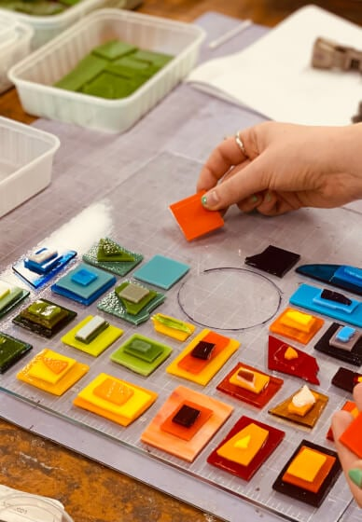
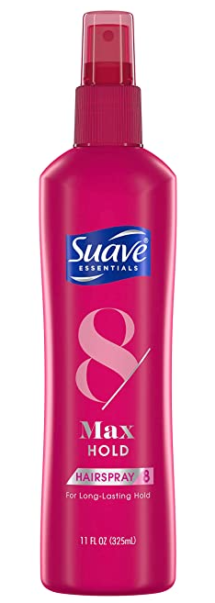
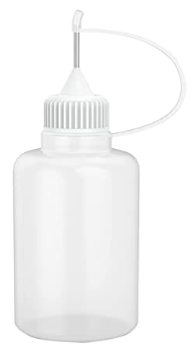
Base Plate + 1 layer + 1 layer + 1 embellishment
Use 1 drop of glue (hairspray) at the edge of each piece you want to tack down and keep from moving.

Slide 13
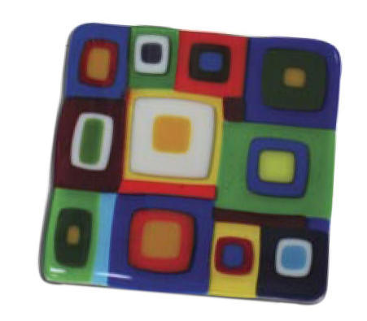
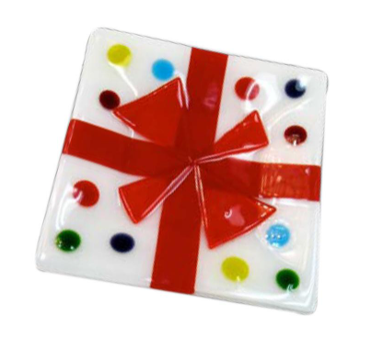
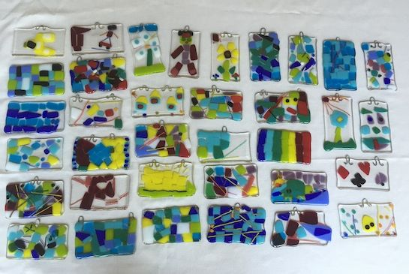
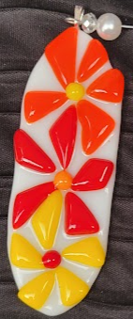
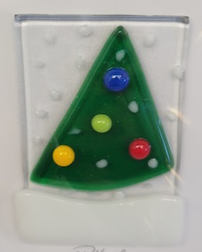
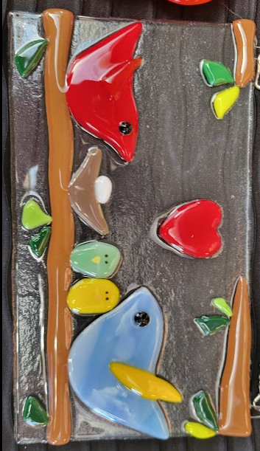
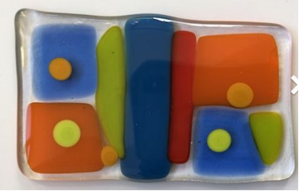
IDEAS

Slide 14
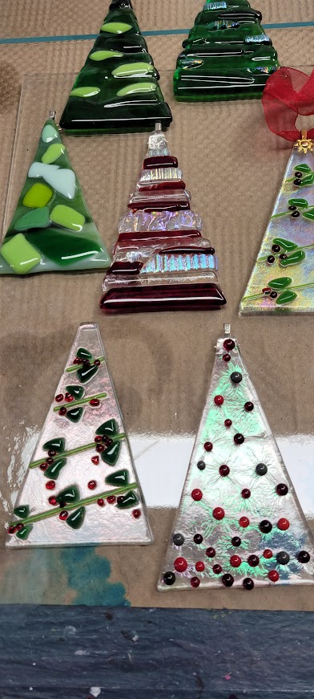
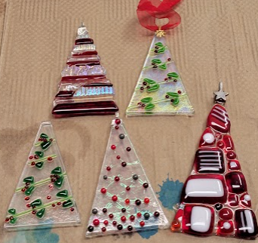
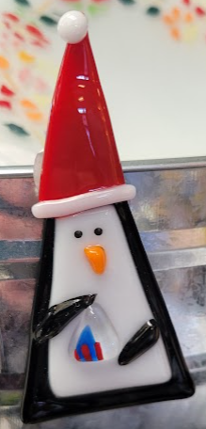
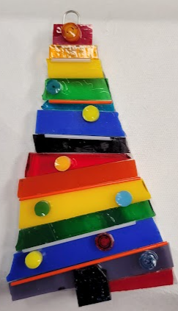
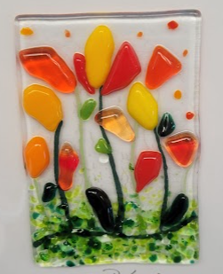
More Ideas

Slide 15
Docent Info
Dust
After firing, kiln shelf paper turns to dust. The dust can be harmful over time if inhaled. To make cleaning easier, you can layer new kiln paper over the used paper a couple times. After about 2-3 firings (or layers of kiln paper) carefully remove the shelf and hold over a bucket of water. Using a very wet sponge, sweep the dust that used to be the kiln paper into the bucket of water. Soaking the whole shelf so no dust is allowed to get airborne. Do not use a vacuum, as it still kicks the dust around the room. Then wash any remaining dust off the projects with tepid water. Wear a small-particle dust mask when working around the dust.
To empty the bucket, pour the water down the drain, but don’t let the sludge go down the drain. Pour the remaining kiln paper sludge into a plastic bag lined trash can.

Slide 16
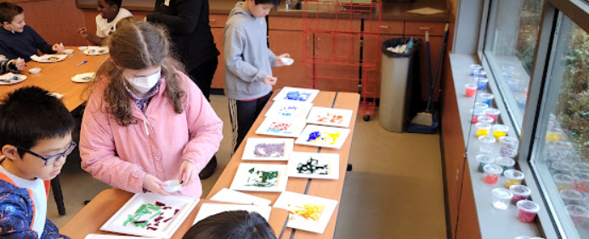
Class Setup
Buy the glass at least 30 days prior to using it.
Arrange a glass cutting party with your docent team. Spend a couple hours over a couple days cutting all the glass into small geometric and organic shapes. Long, short, triangle, square, skinny, wide, etc.
Store each color of cut glass in 5oz ToGo cups with lids.
When setting up for class, pour the glass onto a sturdy paper plate, to allow the students to safely sort through the cut glass for the shapes they want.
Students use the plastic small white water cups to pick out their glass colors and carry back to their seat.

Slide 17
Giving the presentation in the hallway Pod

Slide 18
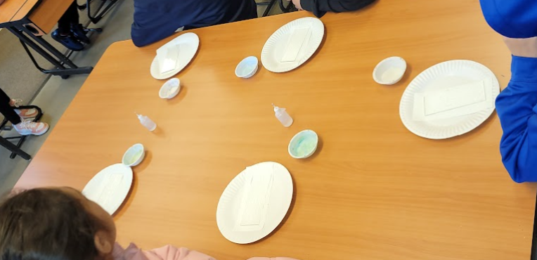
Setting up the student tables:
1 paper plate/student
2-3 bottles of hairspray in squeeze tubes/table
1 plastic cup to transport glass/student
1 clear glass base plate on top of a cut to fit kiln paper/student

Slide 19
Use Paper plates to contain each student’s projects as they work on them.
After they are completed, go through the projects and sort them based on the firing temperature you will use for each project.
F – Full Fuse
C – Contour Fuse
T – Tack Fuse

Slide 20
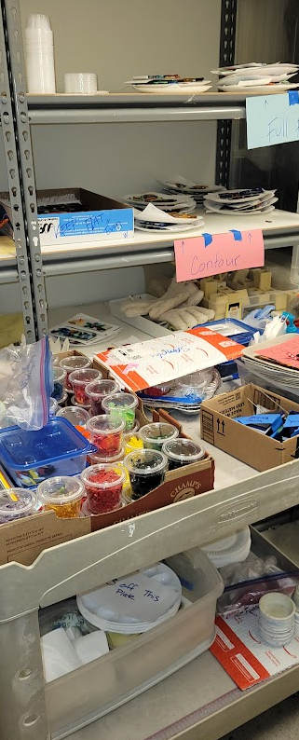
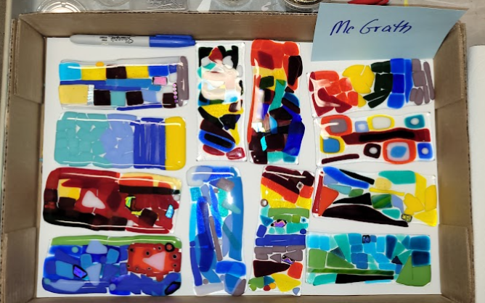
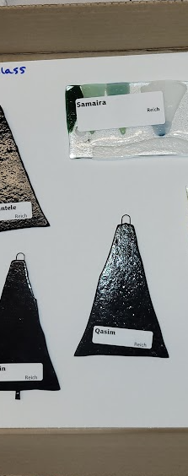
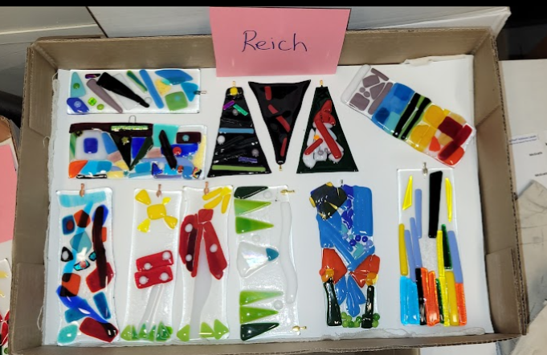
Fire the fused glass based on temperature, not by class/teacher
Use a copy paper box lid as your class tray. When pulling out the glass projects from the kiln, place the label on each project and put it into the correct classroom teacher’s box.

Slide 21
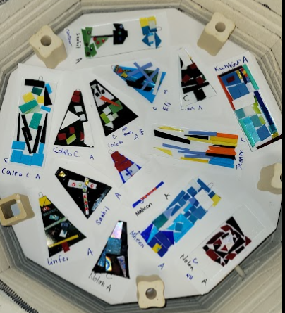
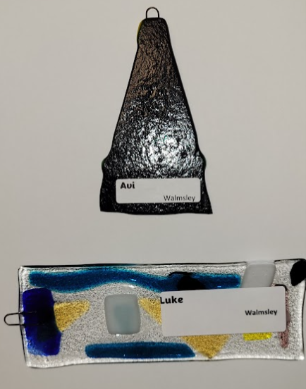
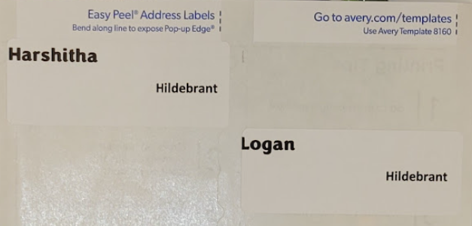
Loading the Kiln
Kiln Paper with Student Name and Teacher Initial.
Take a photo of the kiln as you load it.
Print labels for all students and have them ready to apply to each project when taking them out of the kiln

